Slide 1

Presidential GDP
Group Members
Brittany Douville
Caite Green
Kevin Kahn
Jeremiah Mergenthaler
Tyler Potts

Slide 2
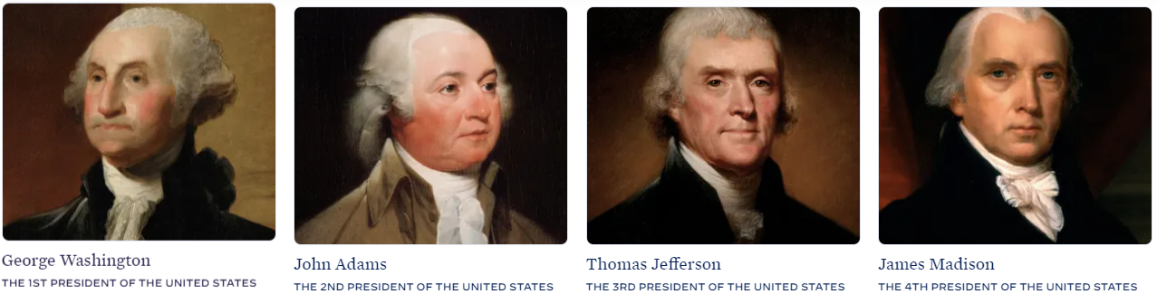

Overview
In our final project for SMU Data Bootcamps our team has decided to use Data Model Implementation and Optimization to try and predict President.
Would the US be prosperous?
Can the model output predict classification accuracy equal to or higher than 75% or with an 0.80 R-squared?
Stage 1
Ingest and clean
Clean, normalize, and standardize data set
Upload data to a database (postgress)
Stage 2
Develop and optimize model
Initializes Python script, trains, and evaluates a model
Model output of predictive power at least 75% classification accuracy or 0.80 R-squared
Optimize model
show iterative changes
show change results in model performance
documented in either a CSV/Excel table or in the Python script
Overall model performance is printed or displayed at the end of the script
Stage 3
Visualize
- Create front end visuals with HTML, CSS, Javascript
Delivberable: President
Chooses a president:
Drop Down, reduces the chance for error and none guesses
Return predictions about the state of the country based on the President:
Would the US be prosperous?
Predicted GDP growth (compare to latest dataset we can find)
Print the predicted model performance

Slide 3
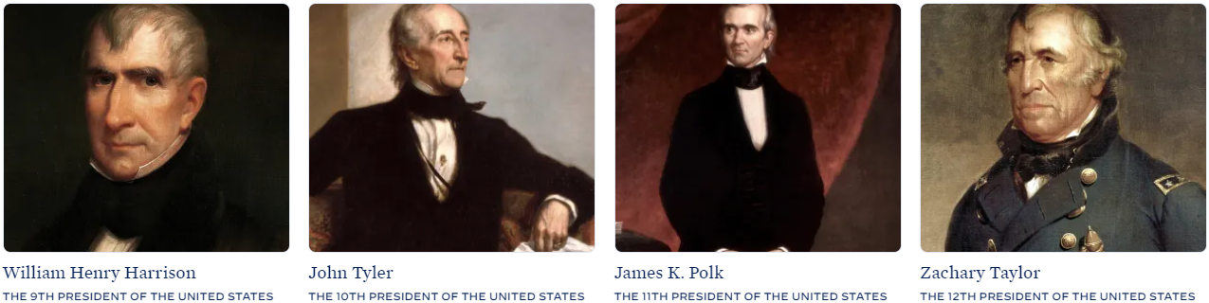
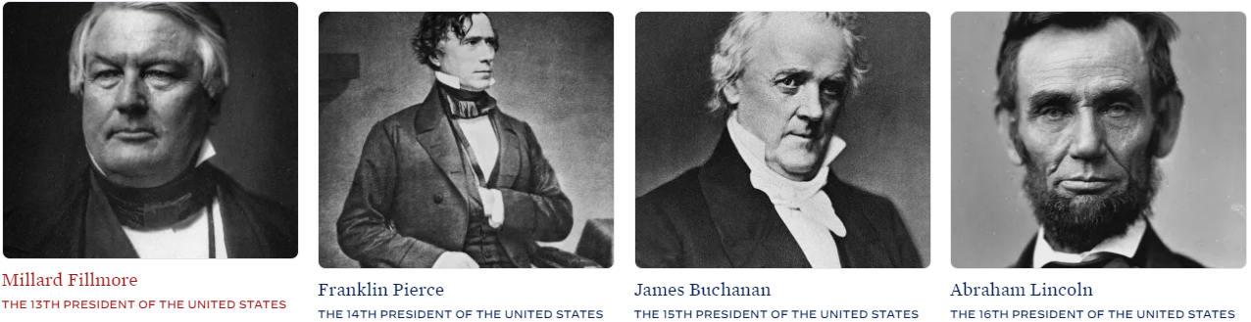

Slide 4
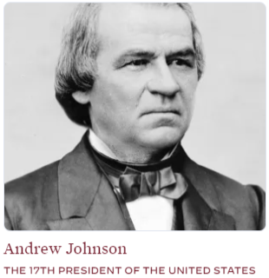
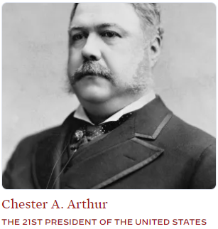
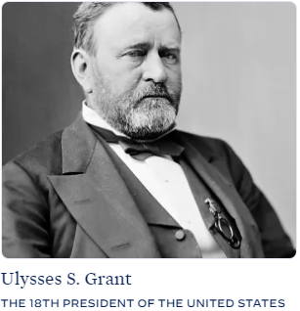
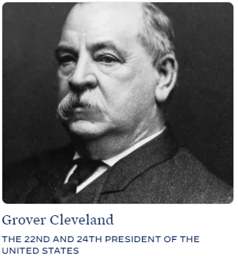
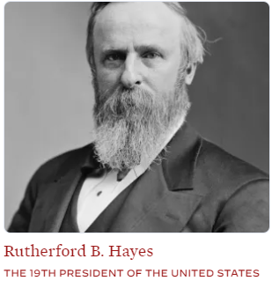
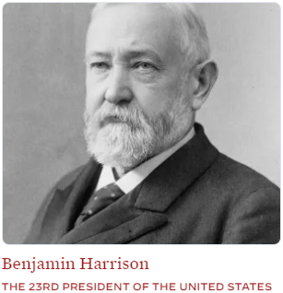
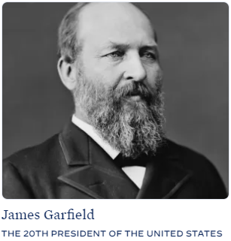
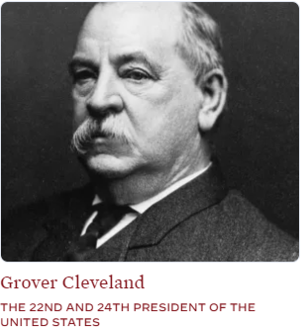

Slide 5
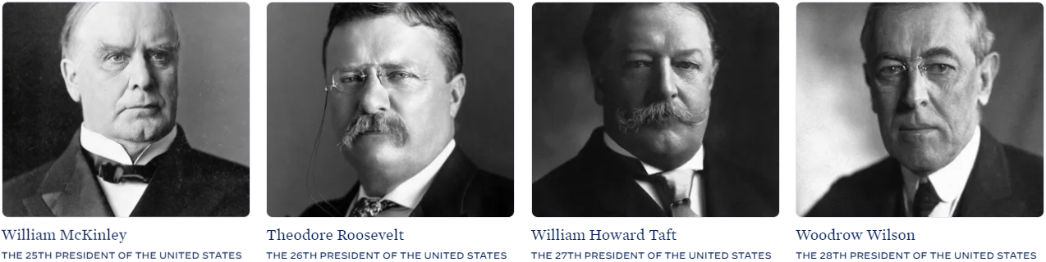
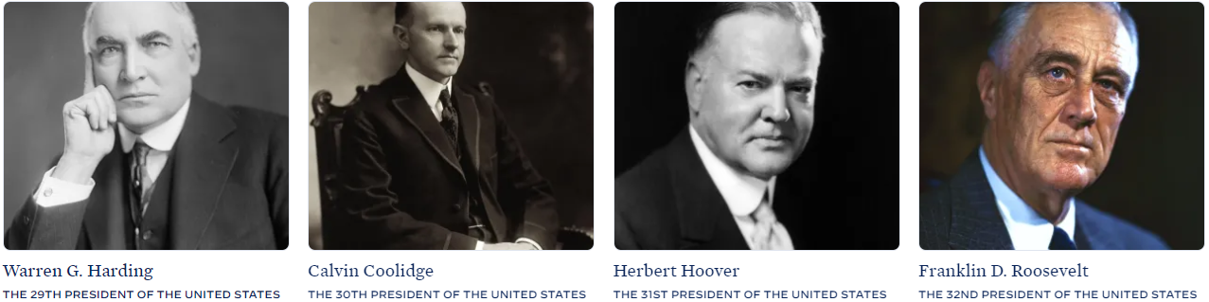

Slide 6
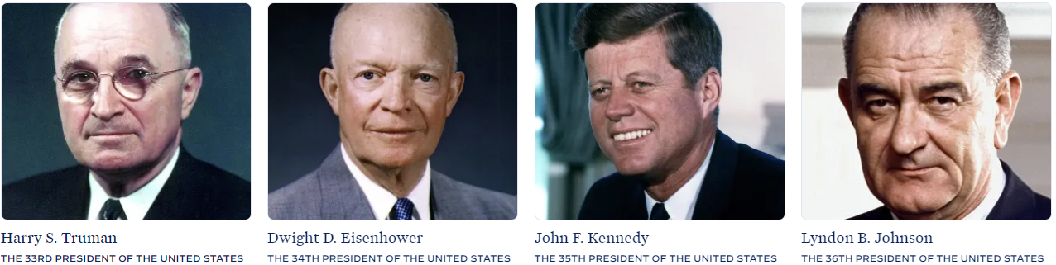
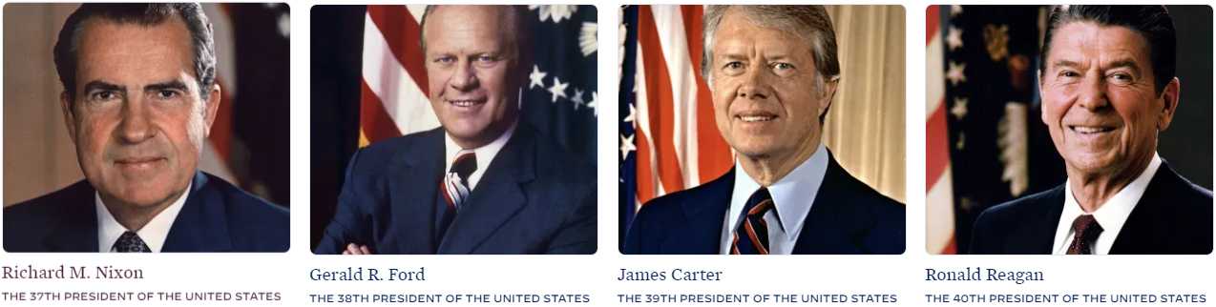

Slide 7
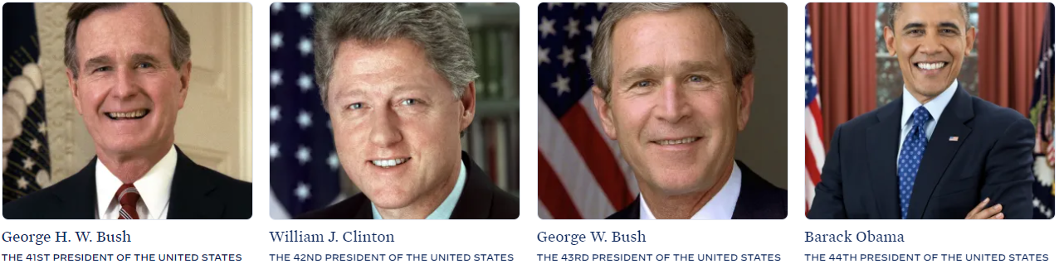

Slide 8
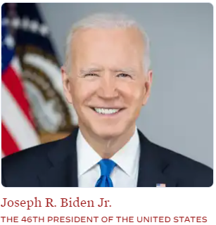
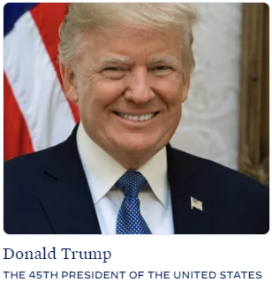
References/Sources
https://csvbase.com/roblillack/birthdates-of-us-presidents?op=gt&n=40
https://github.com/datasets/gdp-us/blob/master/year.csv
https://www.theguardian.com/news/datablog/2012/oct/15/us-presidents-listed#data
https://docs.google.com/spreadsheets/d/1dxg4mIyu02WaccBMS3JjhtQ3E0L4WrqfIf8oApJkpmw/edit?gid=0#gid=0
https://chatgpt.com/
https://www.measuringworth.com/datasets/usgdp/result.php
https://www.whitehouse.gov/about-the-white-house/presidents/

